Slide 1

strictly
CONFIDENTIAL
Data Science Test
Research , Innovation and Ventures, Amadeus
© 2019 Amadeus IT Group SA
Amadeus Research, Innovation and Ventures June 2019
Notes:
Cover example with photo
To change the photo click on the image, go to Picture Tools/Format and Change Picture
To update the text, just click on the text

Slide 2
Instructions
This test is for the Data Scientist Job Position at Amadeus / Innovation and Research Division: Data Science Engineer
Objective of the test:
The objective of this test is to provide the candidates the opportunity to show their competences on data science and their research skills.
Due Date:
From the date of reception, two calendar weeks 23:59 CET
Response format:
You can use any tool/programing language
Free: it could be a written document or a presentation.
Send response to:
Eoin.thomas@amadeus.com
Mourad.Boudia@amadeus.com
Position description

Slide 3
Instructions
Tasks:
Download the datasets. You are free to use one or all datasets
Explore the data following the guidelines provided in slide 7
At the beginning of your report include an abstract summarizing your work (250 words max).
Provide a high level description of your process
Feel free to add any analysis you consider valuable for the study
Do not hesitate to include any kind of chart or table to your analysis
Do not hesitate to include any additional relevant data sources

Slide 4
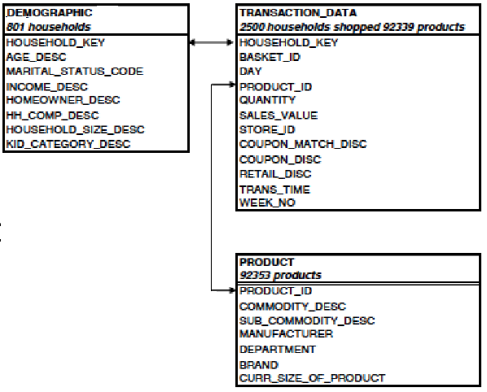
Data Source
Dataset consists on 3 csv files:

Slide 5
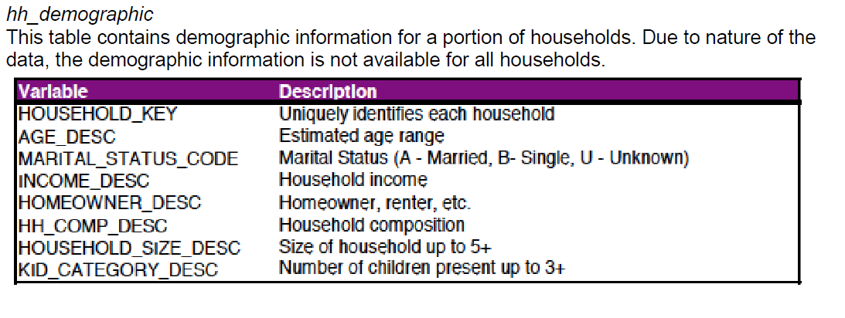
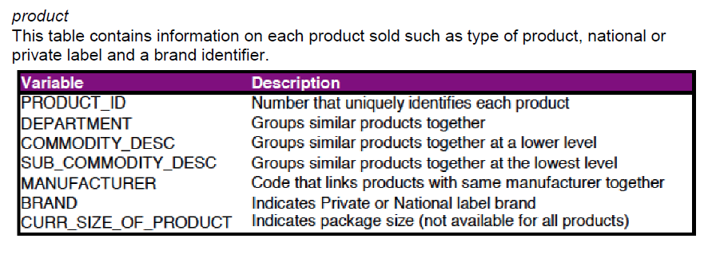
Data Source
Table details:

Slide 6
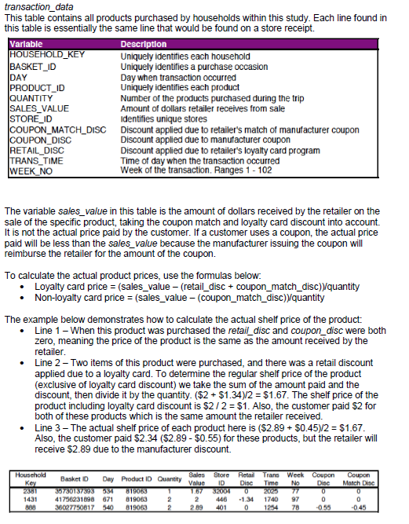
Data Source
Table details:

Slide 7
Content guideline
Which data? What kind of filters?
What are your size limits?
Do not hesitate to look at other data sources to enrich the analysis
Example: - Aggregations (average, min, max, …) - Histograms
- Descriptive charts, ….
(3) Descriptive Analysis
(1) Data Collection
(2) Cleaning / Preprocessing
(6) Advanced Visualization
(4) Predictive Models
Which tools do you use? Why?
Have you preprocessed data before analysis? How? Why?
Example:
Forecast models
Regression models
Machine learning
Choice modeling, ….
(5) Optimization Models
Example:
Use predictive models as input of optimization

Slide 8
Questions:
Quick Validation
How many different products are offered by the store in WEEK_NO=50 ?
What is the best selling product (overall)?
Forecast sales for WEEK_NO = 98 using ARIMA and Random Forests
Which method (ARIMA or Random Forests) would you recommend to use?
Someone suggested that the methods reported Flunkert et al [2] could be used in your work. Do you agree?
Advanced Question
Analysis Question
Research Question [Optional]
[2] https://arxiv.org/pdf/1704.04110.pdf

